Slide 1
SOLAR SMART STREET LIGHT
Submitted by - P7 EE 2nd year To - Prof. Avik Bhattacharya

Slide 2
CONTENT
Aim and objectives
Block diagram
Components
Design and calculation
Approximate cost
Advantages and disadvantages of solar lights
Maintenance of street lights
Future Scope of solar lights
Conclusion

Slide 3
AIM AND OBJECTIVES
Objectives:
Design a 6m tall 25-Watt Street light
Sufficient luminance
Solar powered
Sufficient power backup
Calculation of solar panel size, battery size, street light orientation, cost of setup
The main aim of this project is to develop a solar lighting system that is inclined at an angle to trap maximum solar irradiation, use it to charge a battery during daytime and offer energy to the LED to glow at night.

Slide 4
INTRODUCTION
Solar streetlights are raised light sources which are powered by solar panels generally mounted on the lighting structure or integrated into the pole itself. The solar panels charge a rechargeable battery during the day, which powers a fluorescent or LED lamp during the night. We can also use a controller to control lighting, dimming and battery charging.

Slide 5
Solar
Panel
Controller
Constant current
Driving
Integrated
ciruit
LED
Battery
Street

Slide 6
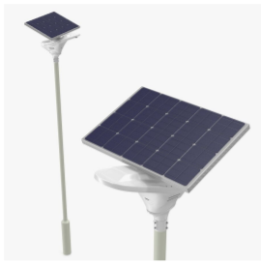

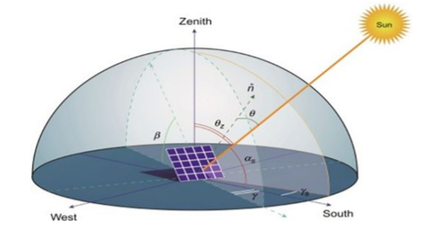
COMPONENTS
Solar Panels
Solar Cells
Installation of Solar Panels
LEDs
Battery
Controller

Slide 7

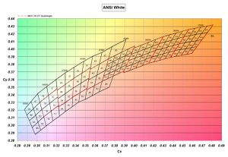
Design and calculation
Wattage and light type
We select a single 25 watt LED panel
From the Lumen chart, we see LED has the highest Efficacy i.e Lumens/Watt = 90 lm/Watt (low power, more brightness)
Another selection criteria is high lifetime of LEDs = 60000+ hrs
Selecting Voltage rating (of each component) = 12V
Lumens = Wattage x Efficacy
→ 25*90 = 2250 lm

Slide 8
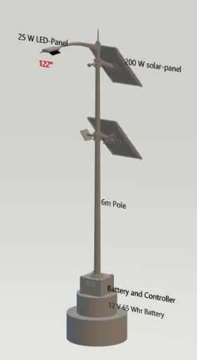
Lumen and lux
We select an average of 6 lux as illumination
Lumen = Average Lux x Area
Approximate Field angle = 122.44°
Battery size calculation
we take a 12V, 65 Amp hour capacity battery.
Capacity of solar panel
187.5 Watts with an average sunlight of 4hrs per day .
Size of Solar Panel
Output power = Total area (A) x Solar Irradiance x Efficiency
200 = A * 1000 * (15/100)
→ A = 1.34 m^2

Slide 9
Approximate Cost
Cost of one 25W LED light panel = ₹500
Cost of one 200W solar panel = ₹6000
Cost of one 12V-65Ah battery = ₹7000
Installation Cost and Overheads = ₹1500
Total fixed cost = ₹500 + ₹6000 +₹7000 + ₹1500 = ₹15000 Total maintenance cost per year = ₹500

Slide 10
Advantages & Disadvantages of Solar Street Lights
Maintenance cost is very less
Incur minimal operational costs
Do not pose any threat of accidents
Continue operation in spite of power cuts and grid failure
Environment friendly, reducing carbon footprints contribution
Expensive than traditional street lights
Risk of threat due to its non wired nature
High maintenance in extreme weather conditions
Replacement of batteries

Slide 11

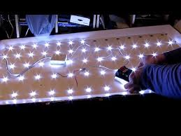
Maintenance of Street light
For routine street lighting maintenance, one shall undertake regular nightly inspections once every two (2) months and provide a report on the following:
● lamp outages
● damaged or missing diffuser.
For non-routine maintenance of street lights, one shall fault-dispatch and/or attend street light sites on a 'call-out' basis to inspect and repair reported faults in the equipment or operation of the street lights.
Notes:
Typical causes of street lighting faults shall include but shall not be limited to ● Control gear malfunctions, ● accident damage, ● storm damage, ● andalism, ● vermin damage, ● fire damage, ● blown lamps

Slide 12
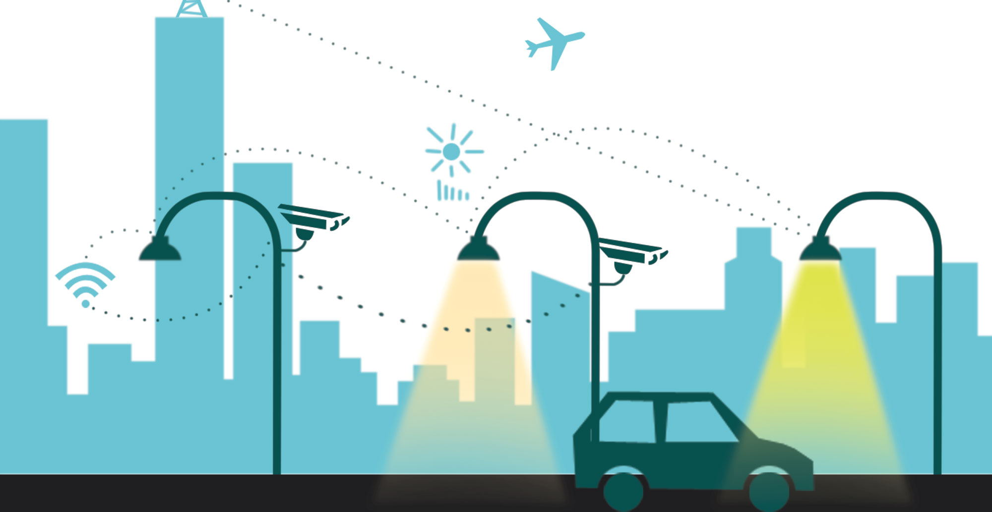
Future Scope of Solar Street Light
Cost Effectiveness: easy installations
Clear Lights for better visibility
Automatic switching ON
Motion Sensors to save energy
Smart Technologies to control from remote locations
Can be modified easily to make it multi-purpose
Notes:
Multipurpoise: Inbuilt pollution monitors ● Mobile device charging points ● Button for emergency services ● Wi-Fi routers ● CCTV cameras ● Digital information display for traffic congestion ● Information on nearby parking spaces ● Charging stations for electric vehicle

Slide 13
Conclusion:
Solar energy is one of the renewable sources of energy. There are many advantages associated with it. With that, it can also be used for other purposes as well. we can conclude is that there is a problem of maintenance and initial investment on solar street lights.
However, with the advances in technology and good resource planning we can cut down the cost of the project and with use of good equipments maintenance frequency can also be reduced.
It can save about 40% electricity from street lights. So following development of the outdoor lighting technique, the solar LED street light system has shown us it will have promising application and infinite vitality.
Notes:
Solar power is an immense source of directly useable energy
So if we use these solar street lights it will eliminate the energy crisis to a large extent.

Slide 14

Contributors:
Sankalp Khanna
Sanskar Gupta
Sanskar Saraf
Sejal Agrawal
Shivam Kumar
Shivam Meena
Shivam Sagar
Saksham Singhal
Sarthak Malik
Sarvesh Prashant Mandewal
Rohan Mallick
Rohit Anil Garde
Rohitaksh Choudhary
S Shanmathi
S.Ketan Suhaas
Sachin Agrawal
Sachin Choudhary
Sachin Kumar
Saloni Sharma
Sama Sai Shriya Mudiraj

